Slide 1

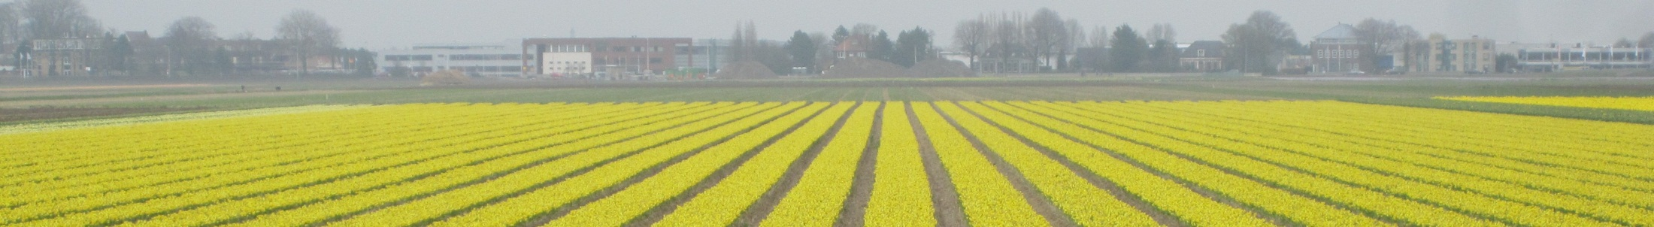

Dan Bolser, EMBL-EBI
trans-National Infrastructure for Plant Genomic Science
transPLANT portal:
Overview and search Versailles, 12th-13th November 2012

Slide 2
The transPLANT portal: Overview
Two types of content:
Project information
Project summary information, news, details, partners, publications, and reports.
Service pages:
Partner resource listings
Resource registry
Integrated search portal

Slide 3
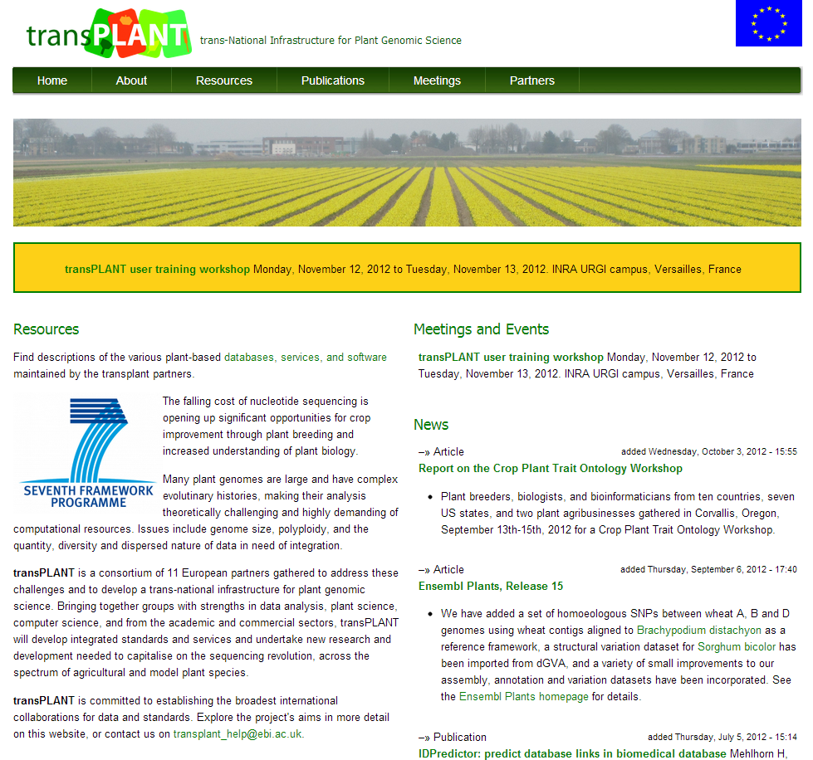

Homepage
Static project summary, links to more info., dynamic listings: project related news / relevant upcoming meetings and workshops. RSS feeds for dynamic content (in and out).

Slide 4
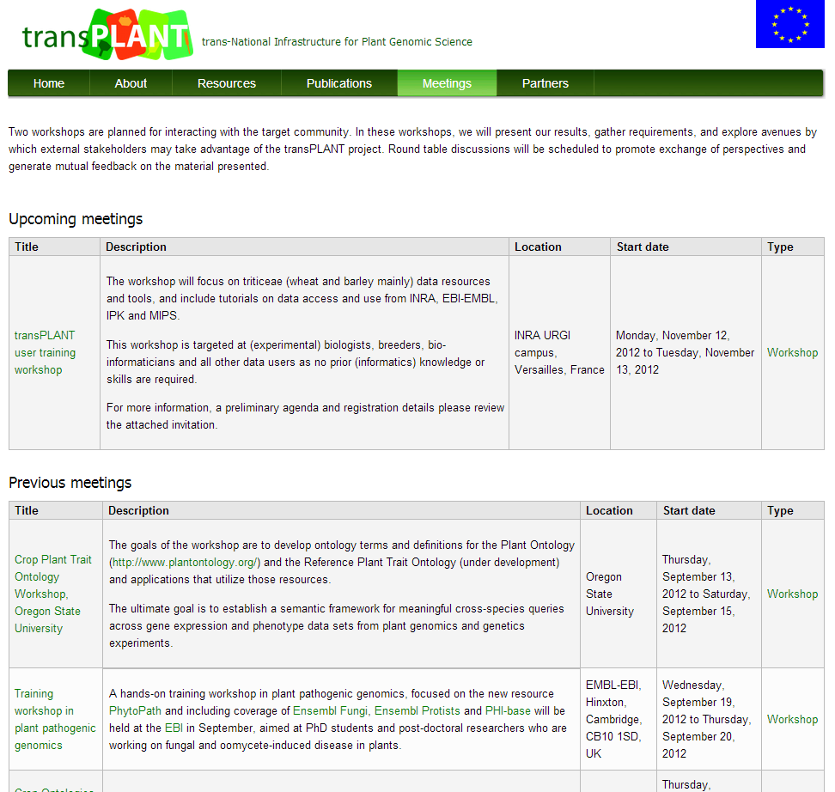
Meetings
Details of all meetings, past and future. Past events include associated resources, such as presentations and reports.

Slide 5
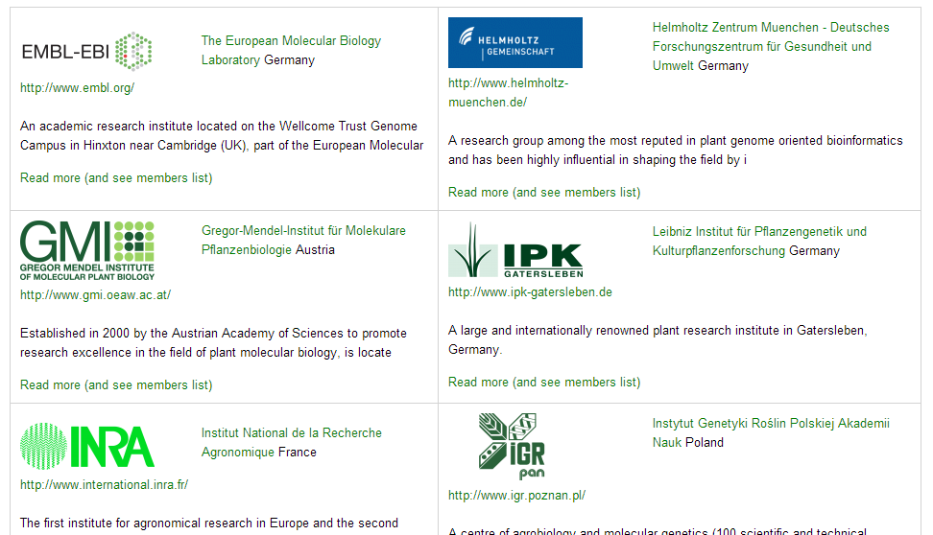
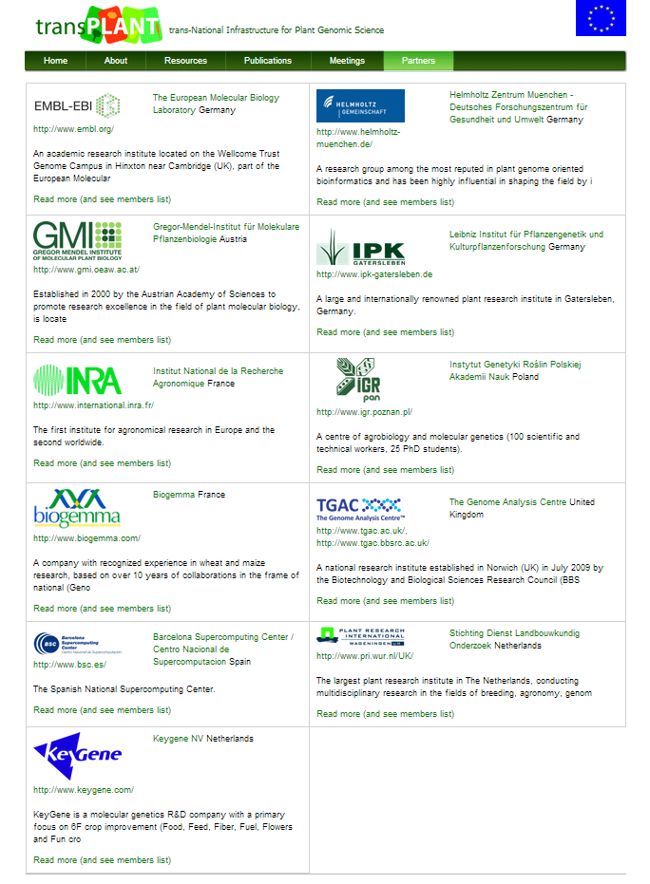
Partners
Complete table of project partners, including logos, short descriptions, and links to homepages. Partner pages include listings of project members and partner resources.

Slide 6
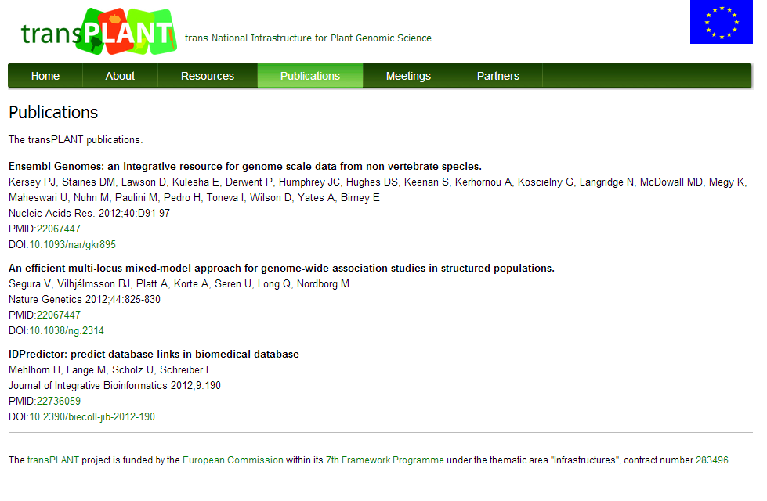
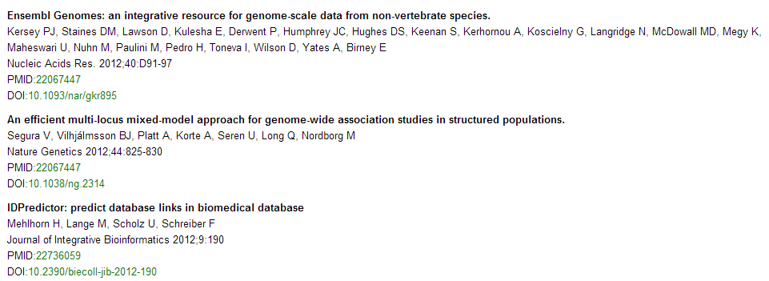
Publications (and reports)
Listings of the outputs of the project, including publications and reports.

Slide 7
The transPLANT portal: Overview
Two types of content:
Project information
Project summary information, news, details, partners, publications, and reports.
Service pages:
Partner resource listings
Resource registry
Integrated search portal

Slide 8
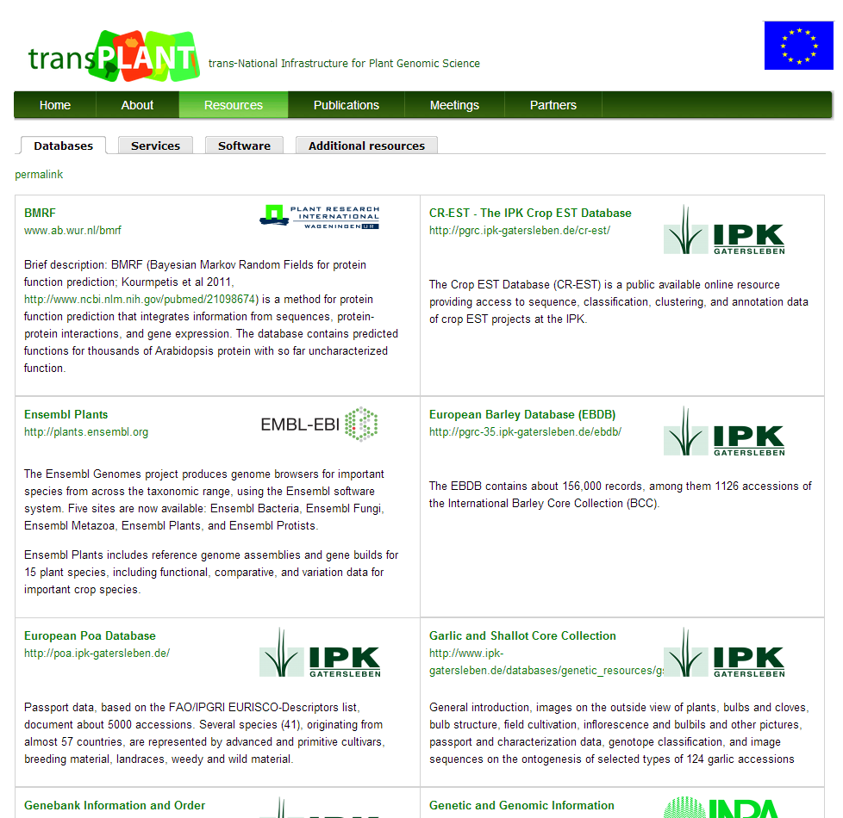

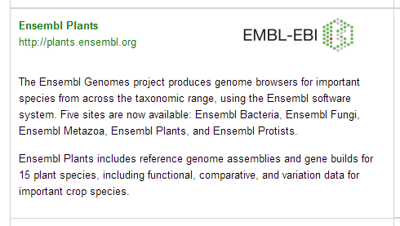
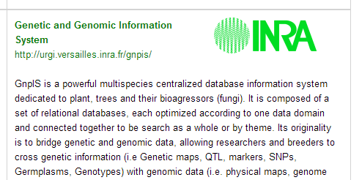
Partner resources
Listing of all relevant resources maintained by the partners broken into three sections: Databases, Services and Software. Table provides descriptions and links.

Slide 9
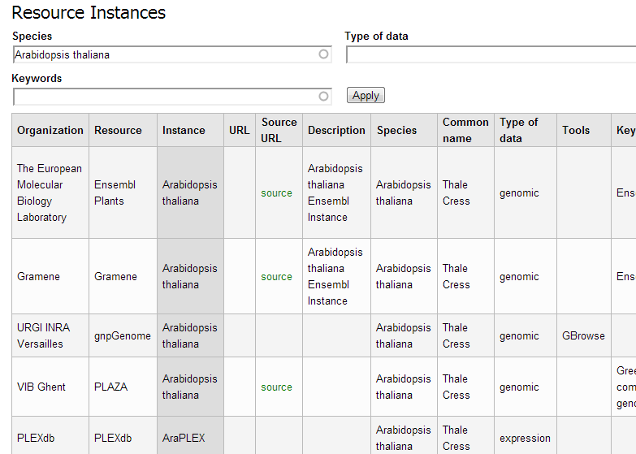
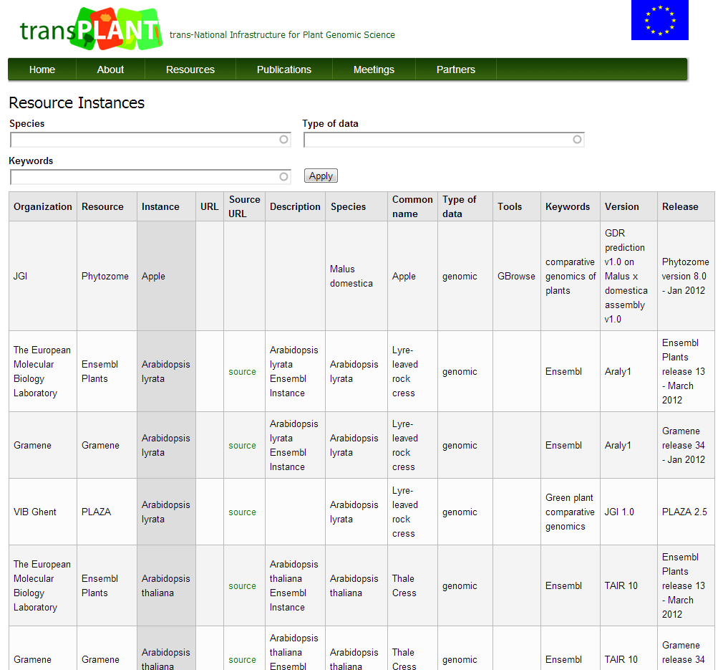
Resource registry
Categorised registry of community-wide resources of interest for plant bioinformatics. List can be browsed or filtered on specific facets of the data.

Slide 10
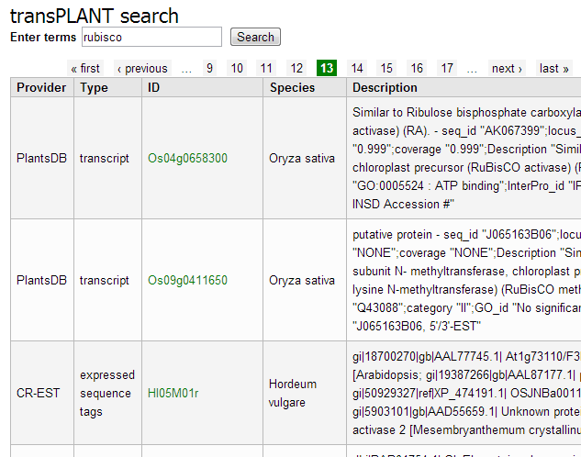
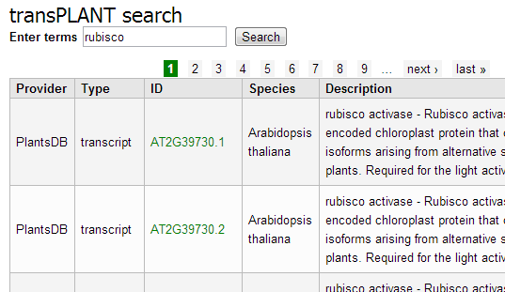
Integrated search
Provide a single search for multiple resources
Results from all data types are integrated into a simple table
Links provided to view each result in the source database

Slide 11
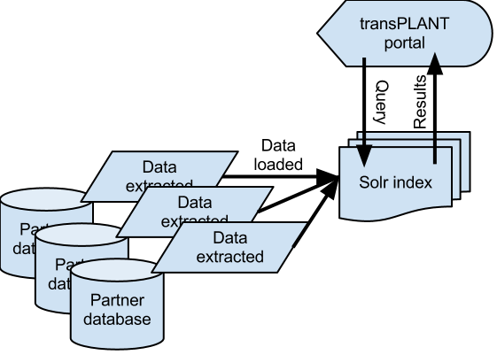
Implementation
Partner data extracted and indexed using a simple schema
Drupal used as a client for querying the Solr index

Slide 12
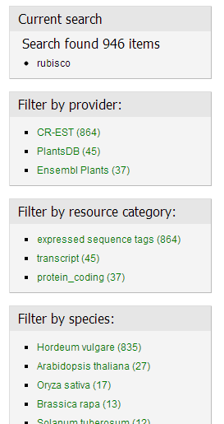
Integrated search
Solr functionality integrated into Drupal using a custom module
Faceted search

Slide 13
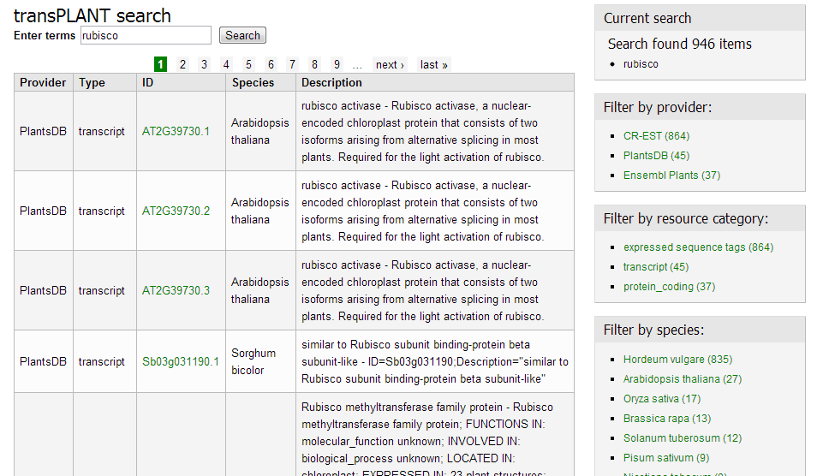
Using facets 1

Slide 14
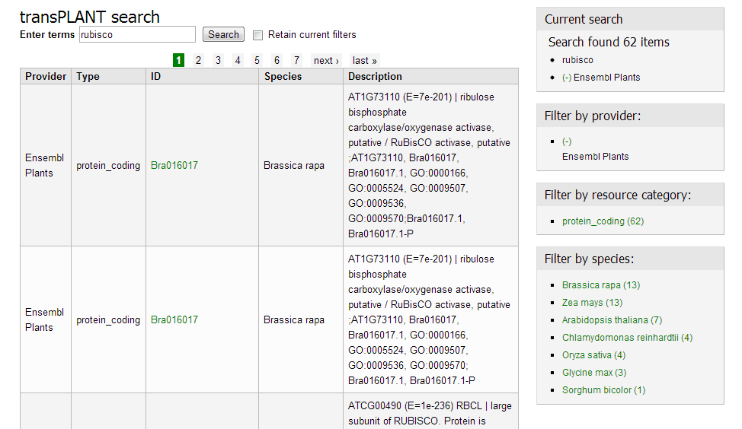
Using facets 2

Slide 15
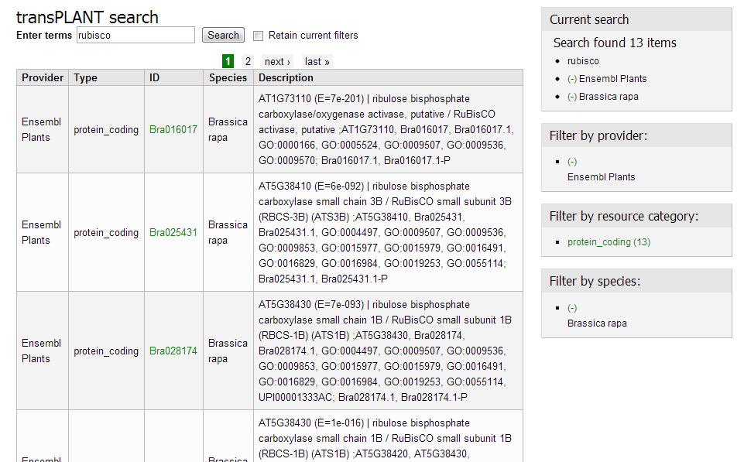
Using facets 3

Slide 16
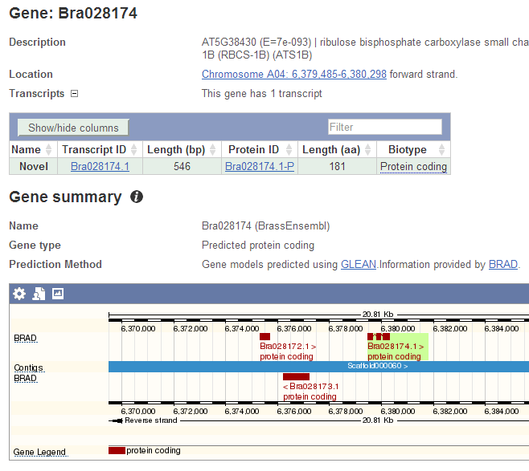
Quickly ‘drill down’ to result of interest…

